Slide 1




LINUX
GUARDIAN

Slide 2
Introduction
Linux Guardian is a lightweight Bash based monitorin tool designed to:
Continuously monitor running processes
Detect abnormal CPU or memory usage
Automatically terminate harmful or runaway processes
Maintain activity logs for system administrators
It acts as a guardian for Linux systems by preventing resource exhaustion

Slide 3
Objective of
Linux Guardian
Protect system performance
Prevent system crashes due to high resource usage
Automate process monitoring
Provide configurable thresholds
Maintain logs for auditing and troubleshooting.

Slide 4
System Architecture
  Main Components
  1. menu.sh
  User interface (menu-driven)
  2. monitor.sh
  Background monitoring engine
  3. thresholds.conf
  Configuration file for limits
  4. logs/activity.txt
  Stores monitoring activity

Slide 5
Menu Script (menu.sh)
  Features:
  Displays interactive menu
  Allows user to:
  Start monitoring
  View logs
  Clear logs
  Change CPU & memory thresholds
  Exit program
  .

Slide 6
Key Advantages
User friendly interface
Automated CPU & memory monitoring
Real-time threshold updates
No manual script editing required
Lightweight and fast execution
Works on any Linux system
Automatic process termination

Slide 7
Monitoring Script (monitor.sh)
Functionality:
Loads CPU and memory limits from thresholds.conf
Checks all running processes every 5 seconds
Identifies processes exceeding limits
Attempts soft kill (SIGTERM)
If unsuccessful, applies force kill (SIGKILL)

Slide 8
Process Termination Strategy
Two Steps Killing Method
1. Soft Kill
code : kill -15 PID
Allows graceful shutdown
2. Force Kill
code : kill -9 PID
Used only if process does not stop

Slide 9
Threshold Configuration (thresholds.conf)
Configurable Limits:
Code: CPU_LIMIT=50
MEM_LIMIT=30
CPU limit in percentage
Memory limit in percentage
Can be changed directly from the menu
No script restart required

Slide 10
Logging System
Activity Log Format
Each entry contains:
Process ID
Process Name
CPU Usage
Memory Usage
Timestamp
Action Taken (Soft/Force Kill)
Example Log Entry
1234 | firefox | CPU : 78% | MEM : 40% | 2025-01-10 12:30:15 | Force Killed

Slide 11
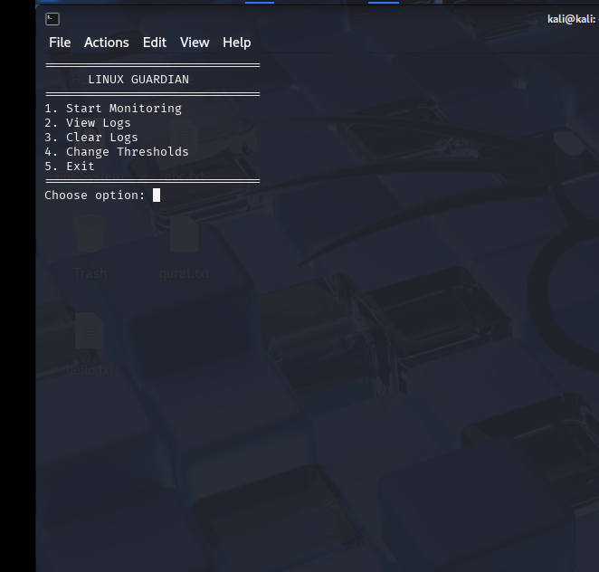
Menu

Slide 12
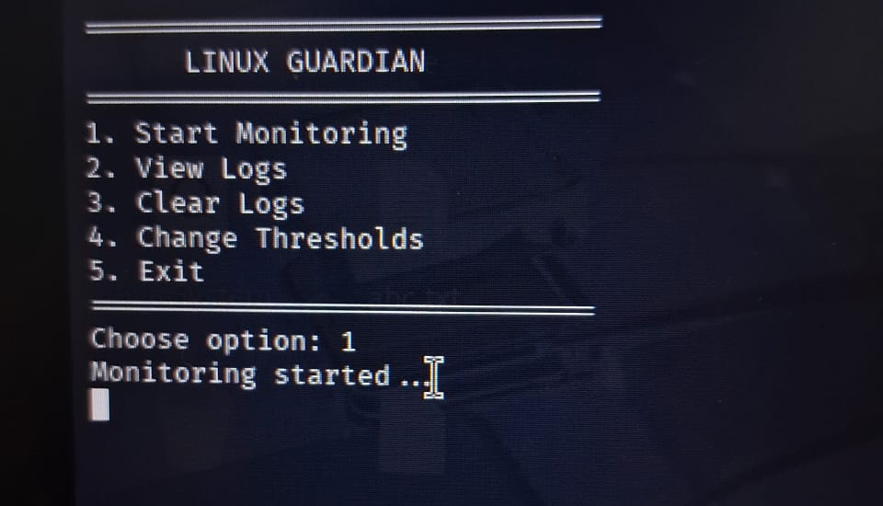
Start Monitoring

Slide 13
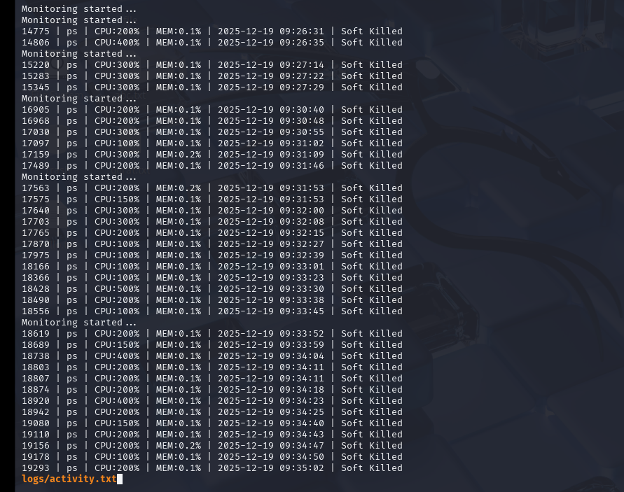
View Logs

Slide 14
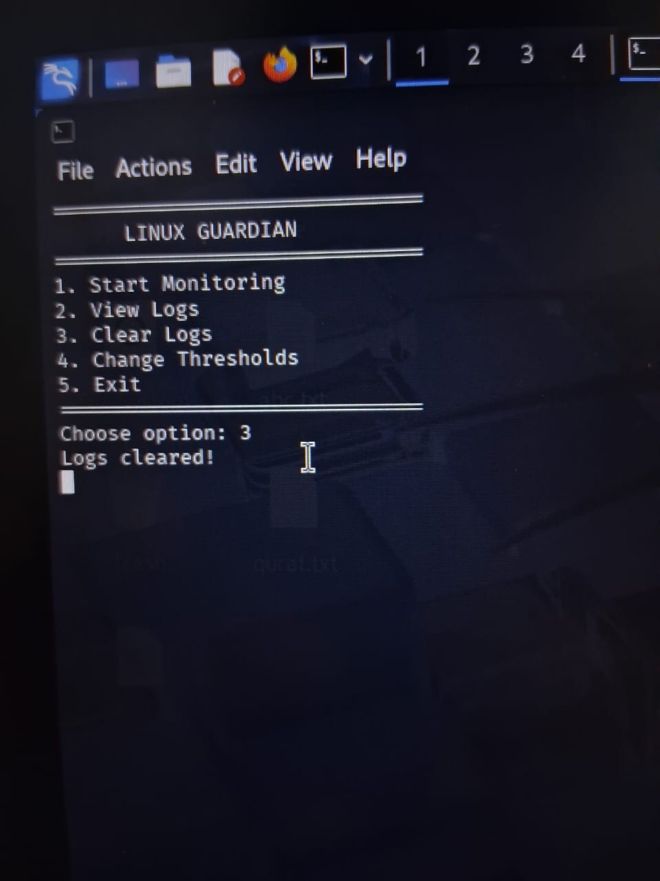
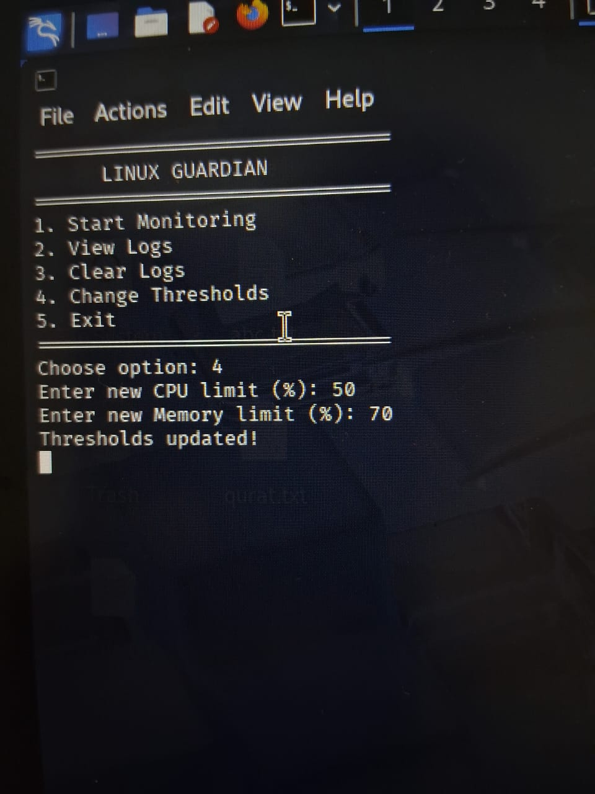
Clear logs &
Change Thresholds

Slide 15
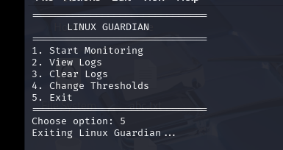
Exiting

Slide 16
Advantages of
Linux Guardian
Lightweight and fast
Fully Automated
Customizable thresholds
Improves System Stability
Easy to deploy on any Linux System
No external dependencies

Slide 17
Limitations
No Graphical Interface
No White List for trusted processes
Requires root privileges to kill processes
Can terminate critical system processes if limits are misconfigured

Slide 18
Future Enhancements
Add Process Whitelist.
Emails or Notifications alerts.
Graphical User Interphase (GUI).
Per User Process monitoring.
Real-time Dashboard.
Log rotation and compression.

Slide 19
Conclusion
Linux Guardian is a simple yet powerful Linux security and performance that:
Protects system resources
Automates Monitoring
Improves Reliability
Demonstrates effective use of bash scripting

Slide 20
THANK YOU

